Slide 1
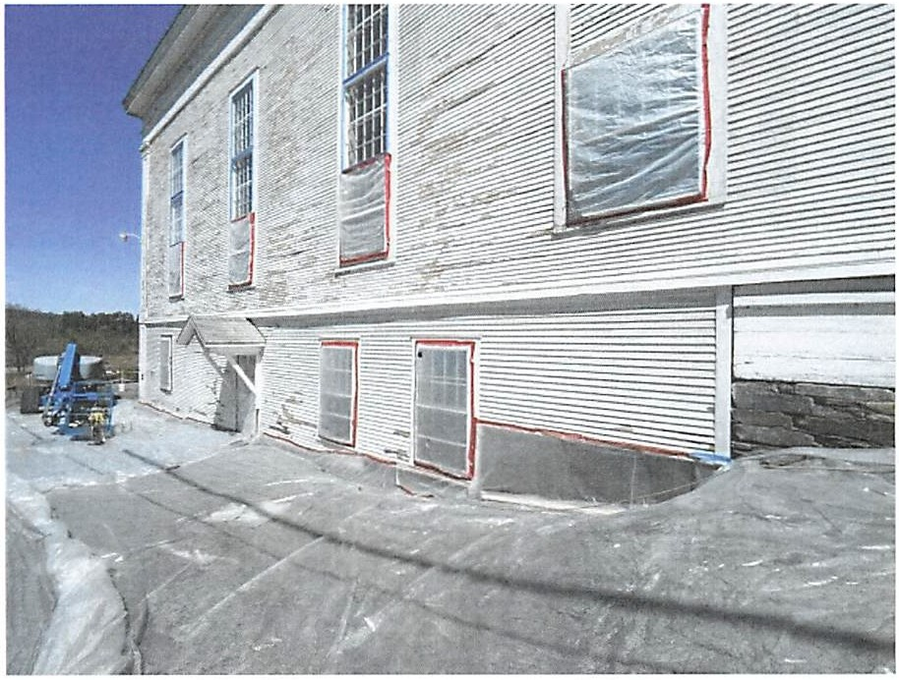
Christopher J. Seufert, Esquire Seufert Law Office, PA
59 Central St, Franklin NH 03235
(603) 934-9837
cseufert@seufertlaw.com
MONEY GUNS AND LAWYERS

Slide 2
WHY GRAMMA
WHAT BIG TEETH YOU HAVE

Slide 3
EPA Enforcement

Slide 4
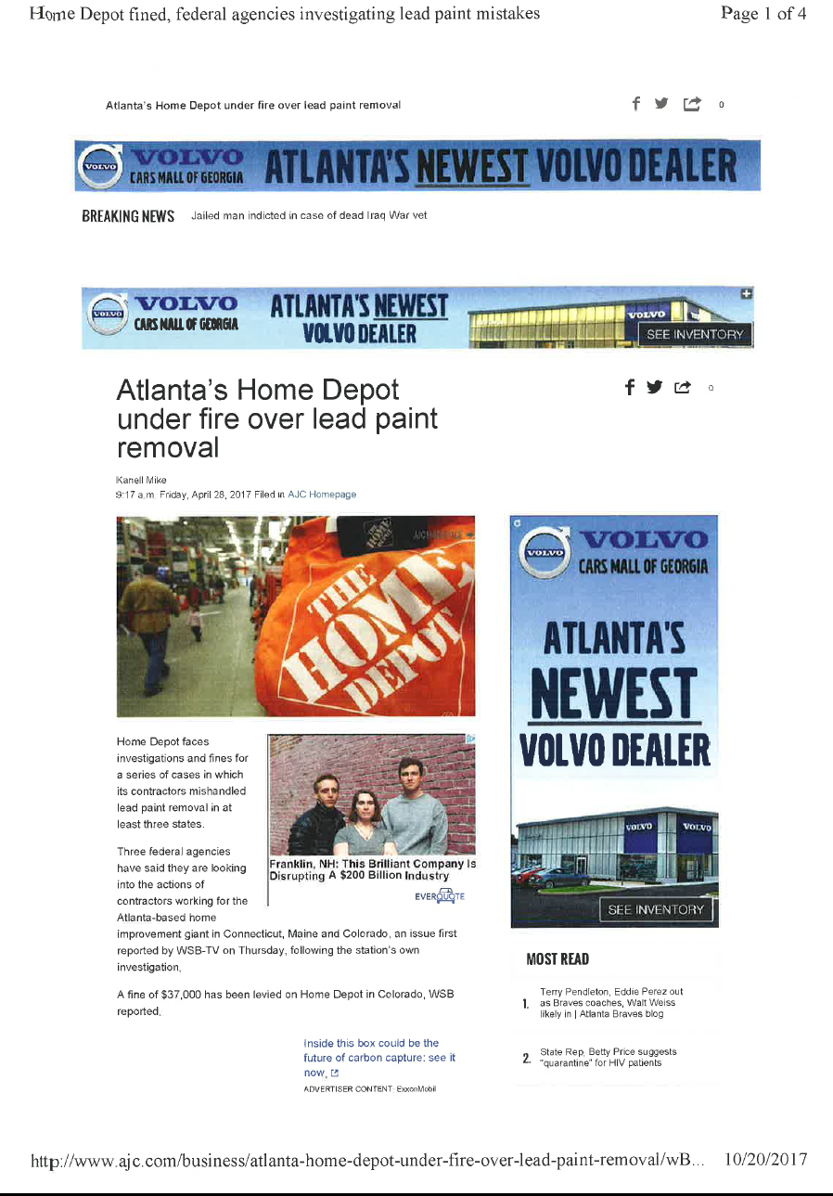

Slide 6
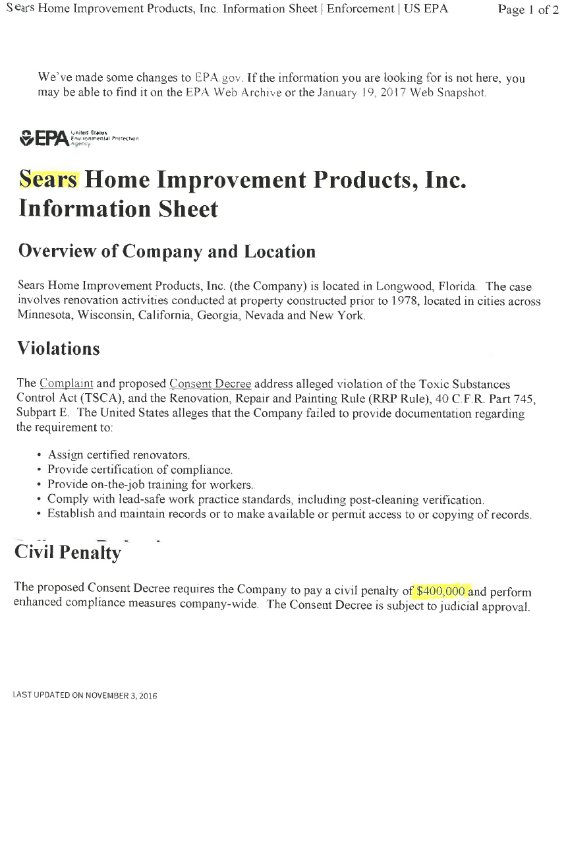

Slide 7
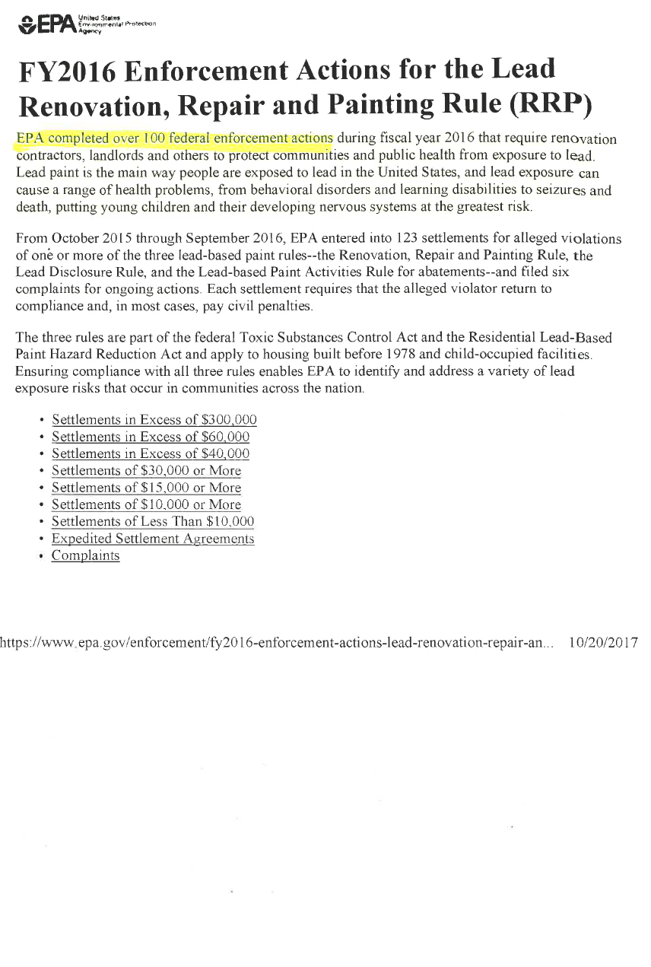

Slide 8
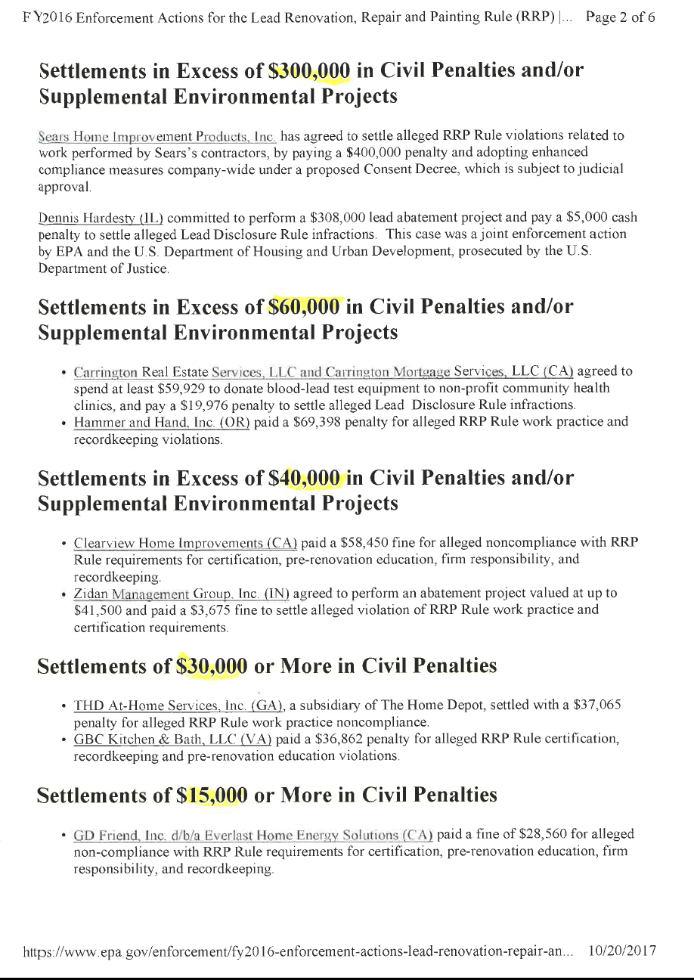

Slide 9
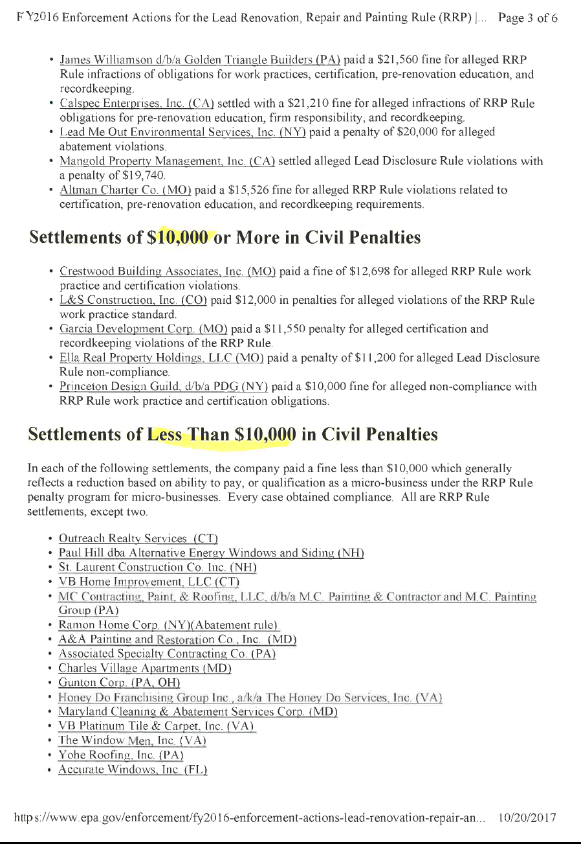

Slide 10
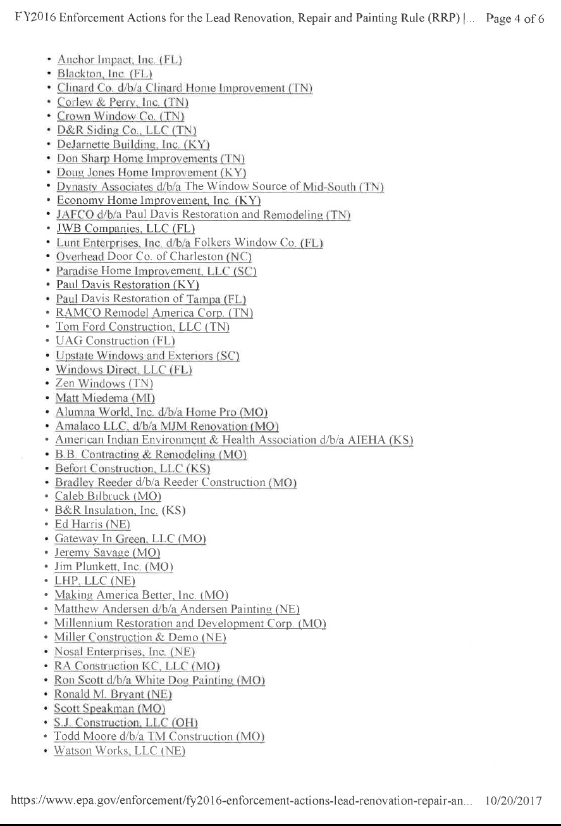

Slide 11
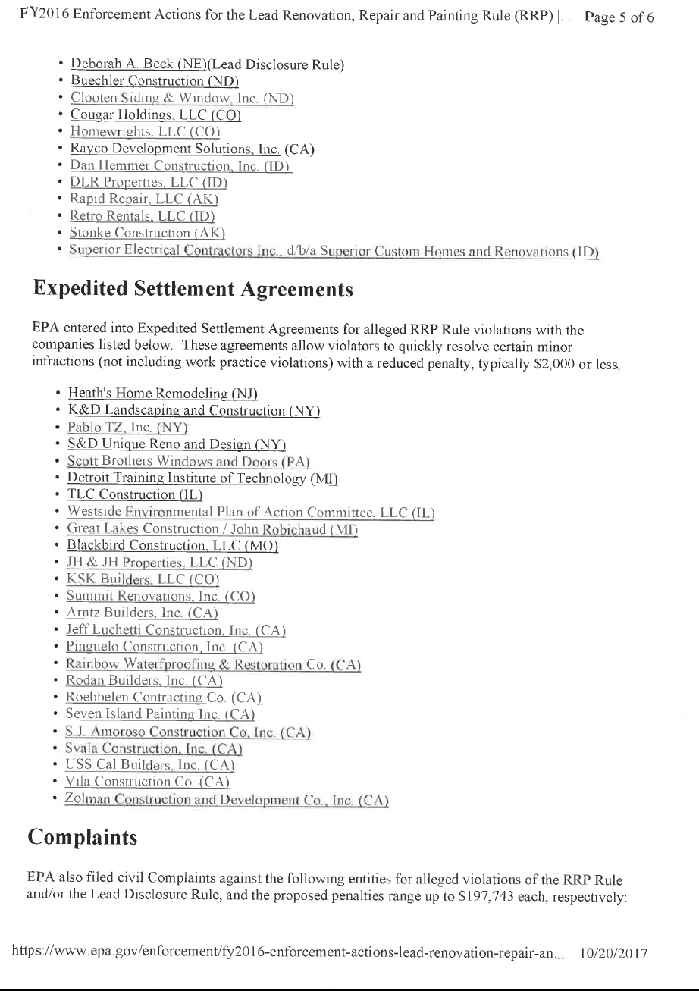

Slide 12
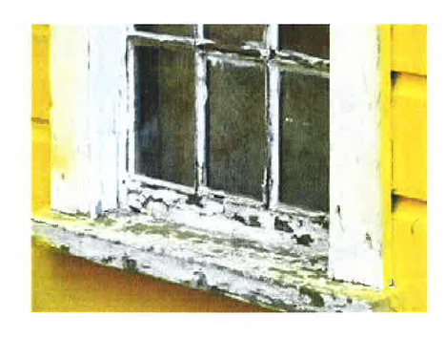
YOU THINK THE EPA IS YOUR WORST NIGHTMARE?

Slide 13
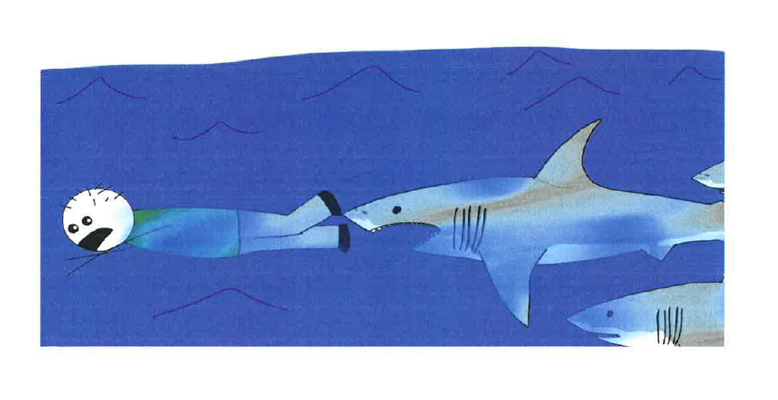
YOUR GOING TO NEED A BIGGER BOAT

Slide 14
SUMMER = YOU

Slide 15
POISONED CHILD = LAWYER

Slide 16
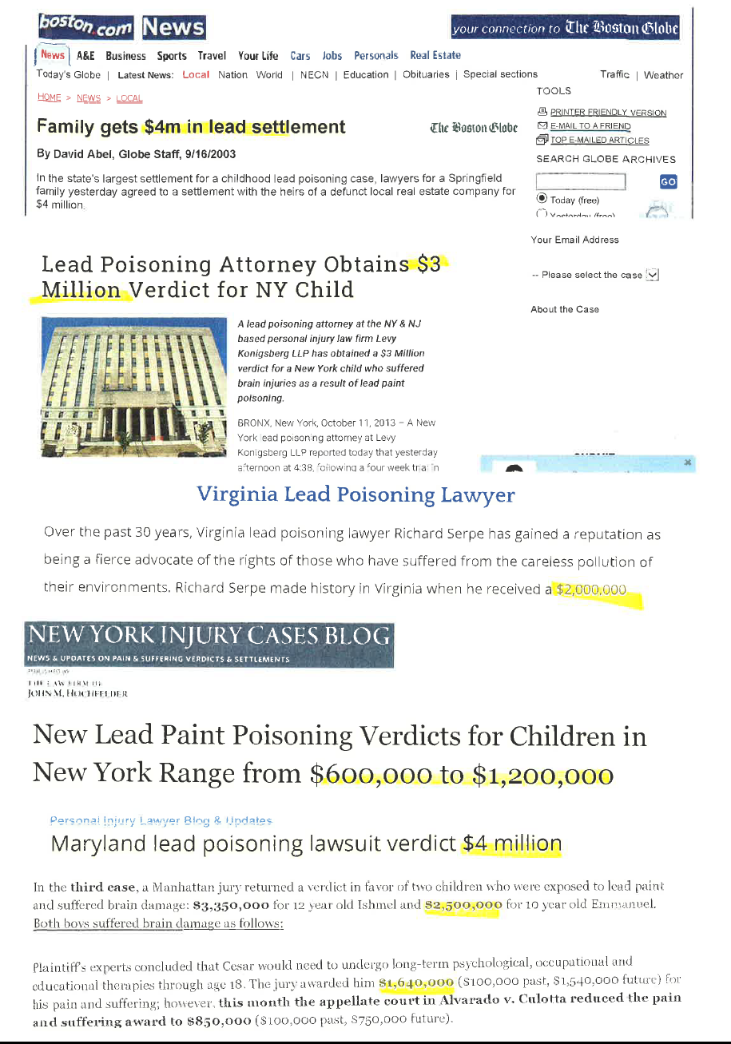

Slide 17
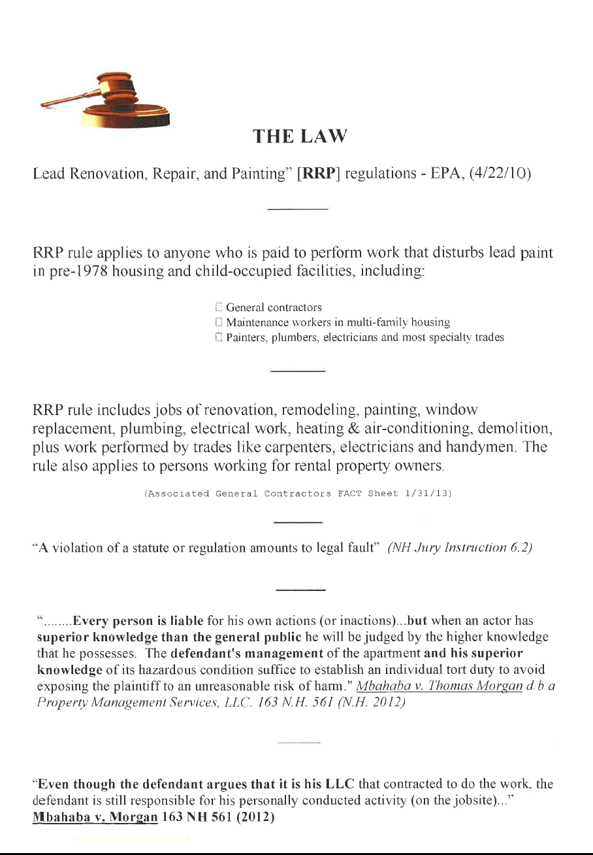

Slide 18
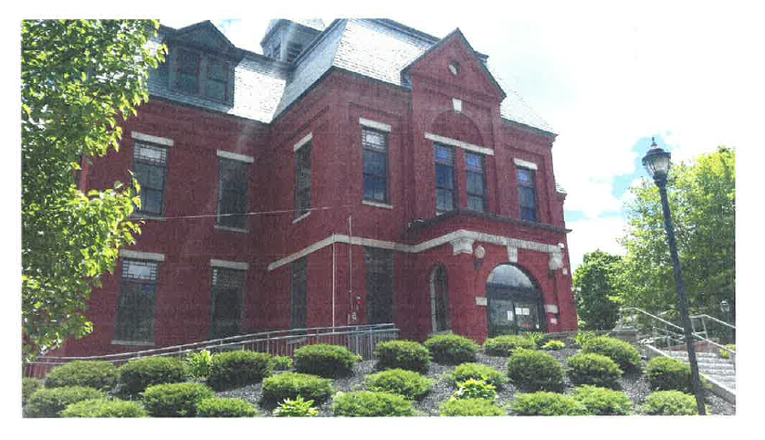
NOT JUST PERSONAL INJURY CASES ANYMORE

Slide 19
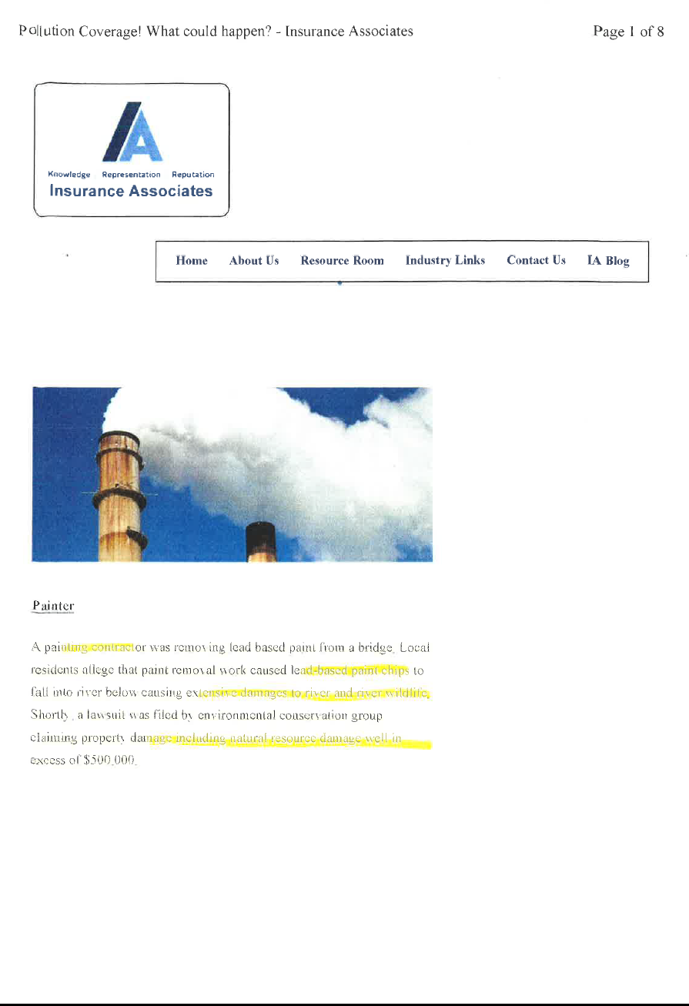

Slide 20
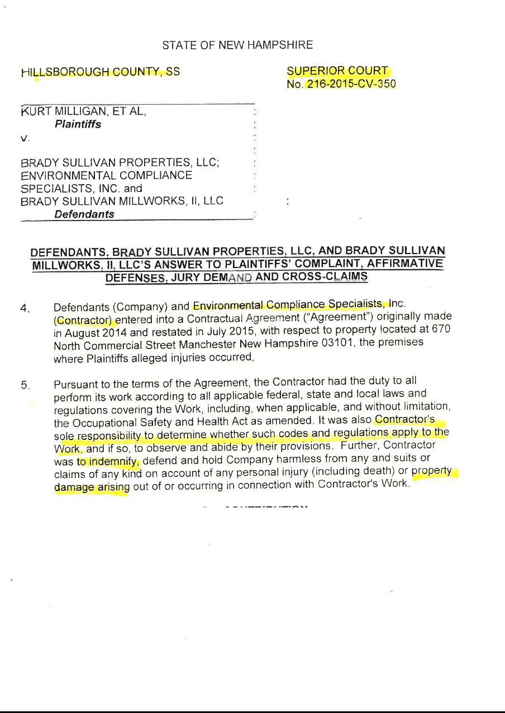

Slide 21
LIABILITY OF CONTRACTORS AND PROPERTY MANAGERS
NO PROBLEM – I’M INSURED

Slide 23
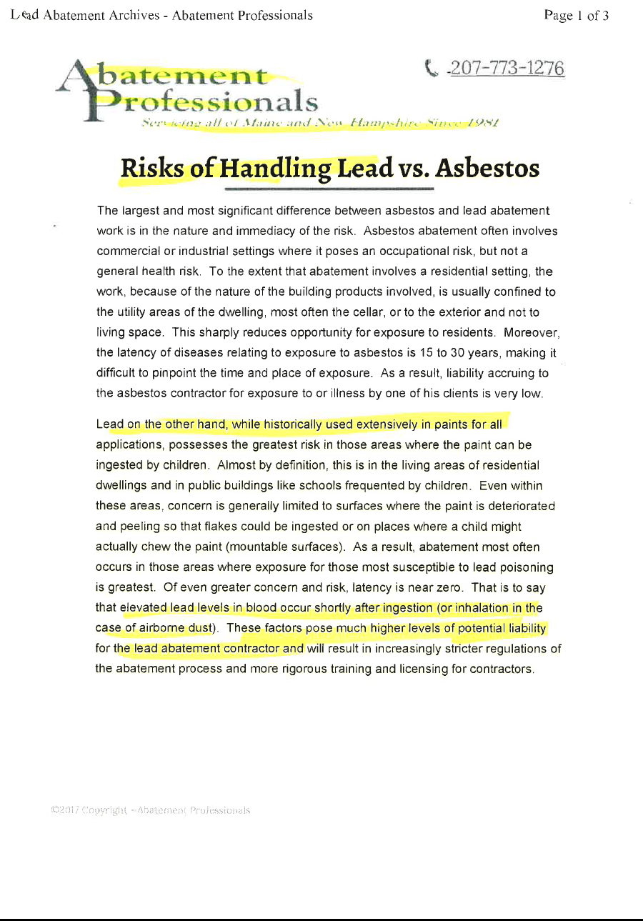

Slide 24
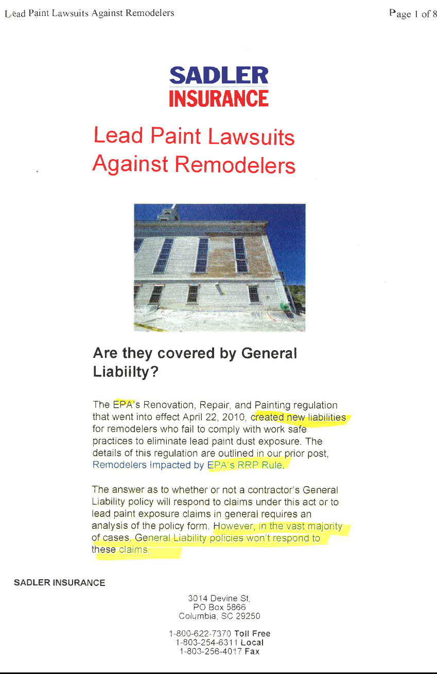

Slide 25
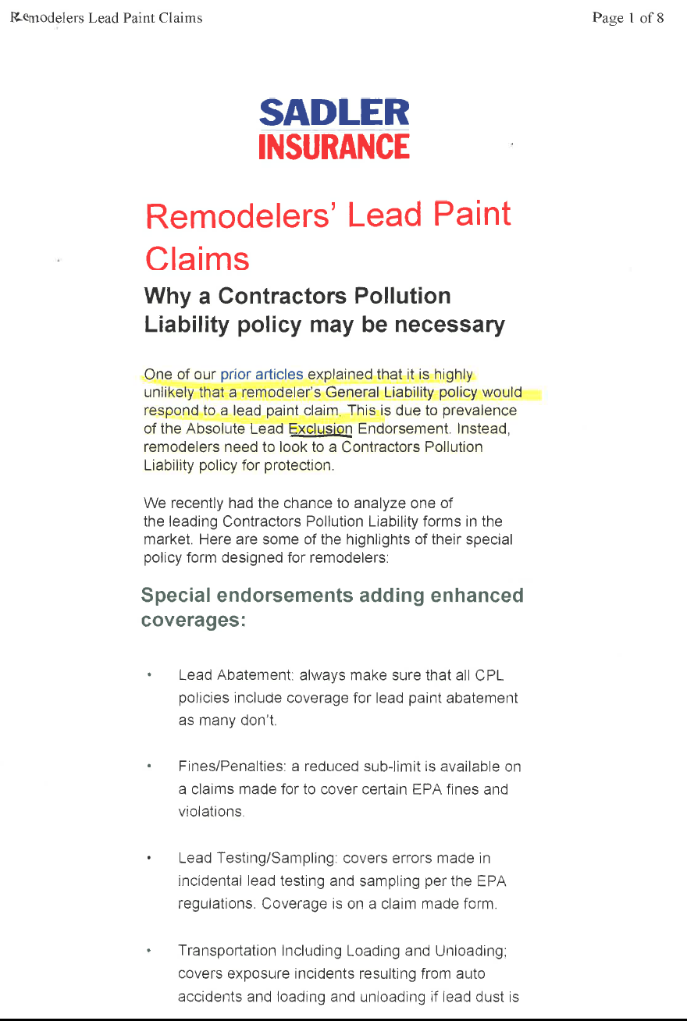

Slide 26
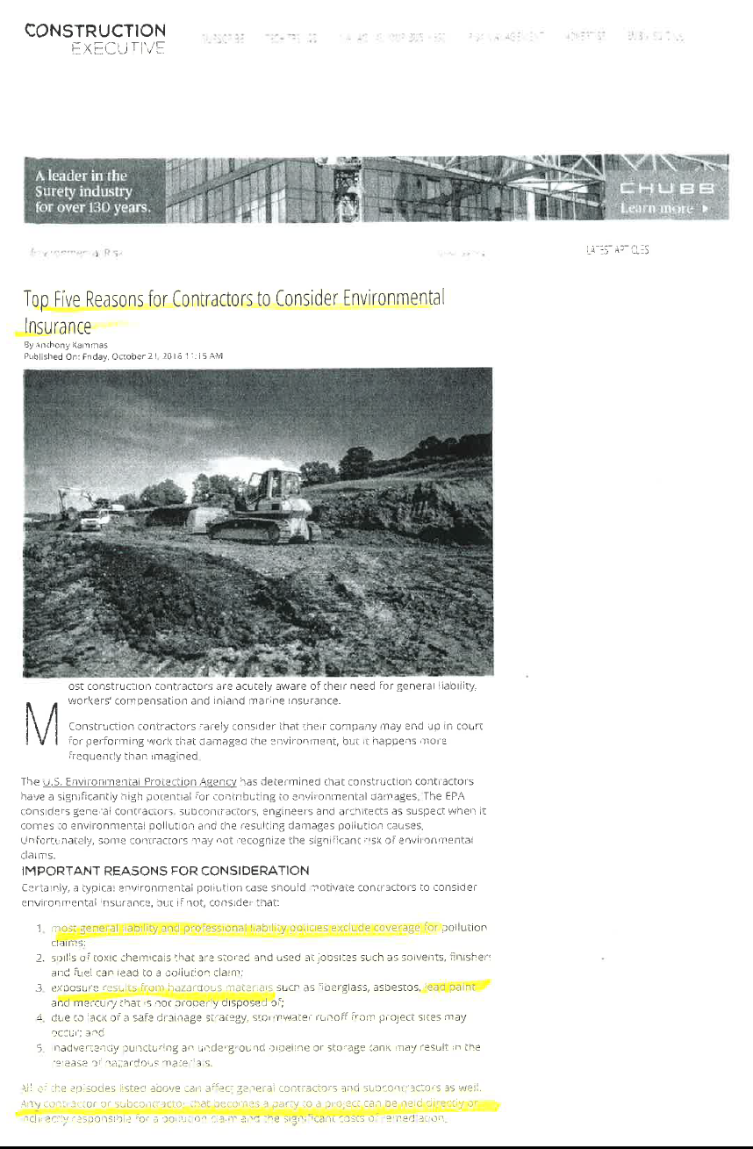

Slide 27
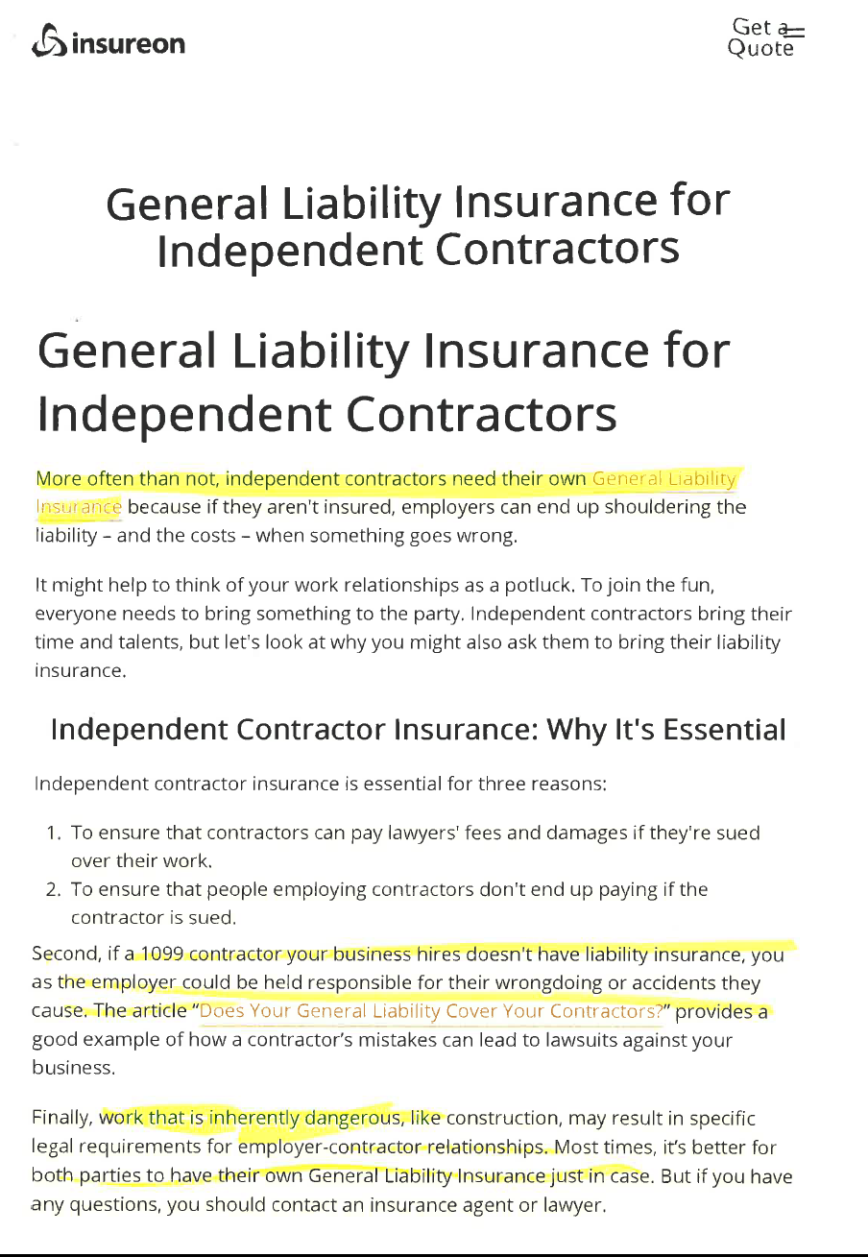

Slide 28
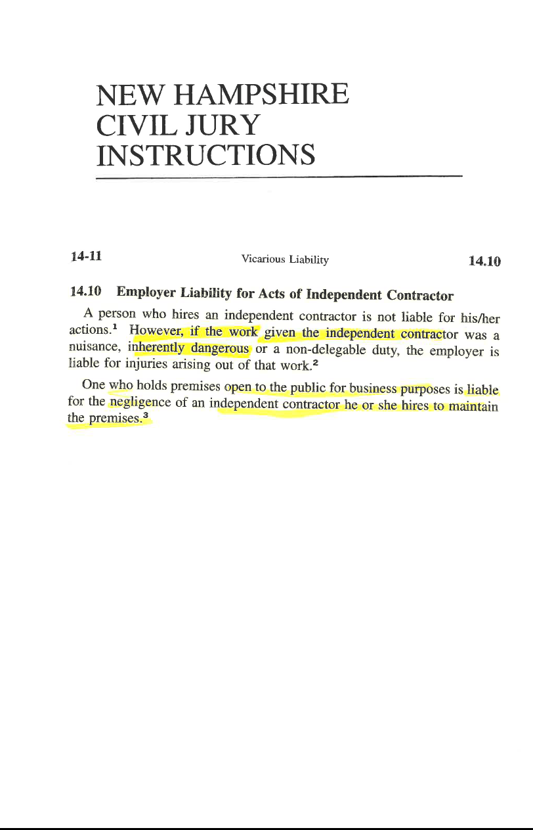

Slide 29
AND AS I ALWAYS LIKE TO WARN

Slide 30
